Slide 1

TRAINING
MANUAL

Slide 2
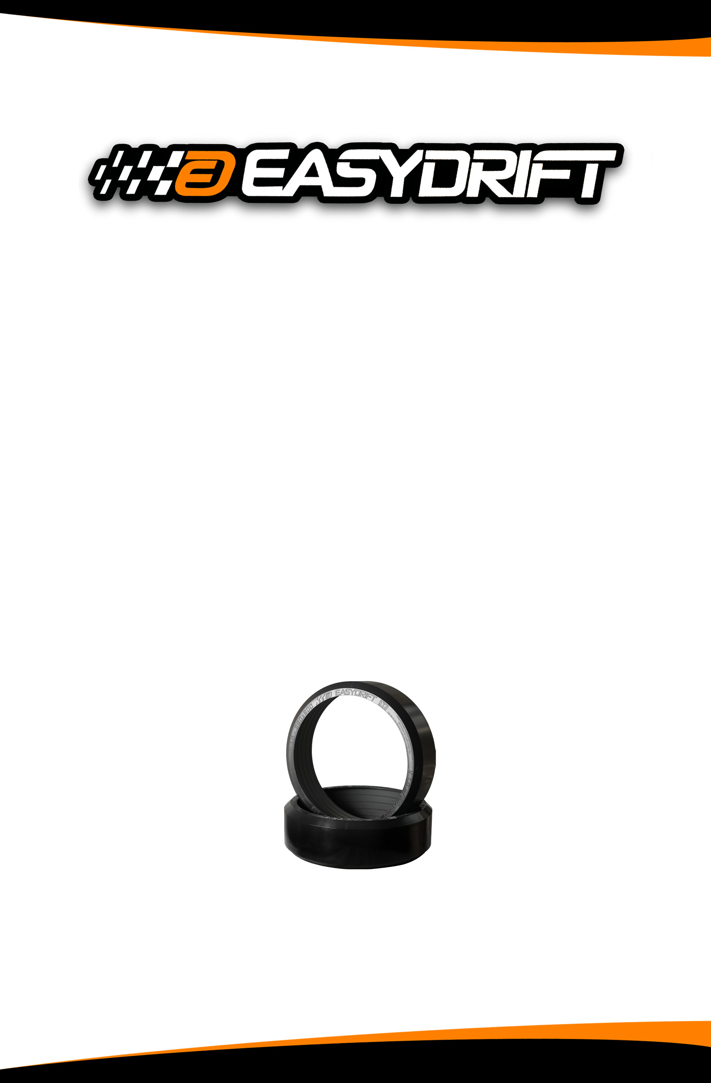
TRAINING
MANUAL
Although the following exercises are designed to teach specific vehicle control principles, they are also skid recovery and avoidance exercises. They all can be conducted without the use of a traditional skid pad.

Slide 3
EASYDRIFT SCHOOL
EASYDRIFT Instructor Certification Course
4 hours classroom
4 hours driving range
EASYDRIFT Master Instructor Course
40 hours of which approximately 16 hours in a classroom
To register please go to:
http://www.easydriftusa.com/training-registration/

Slide 4

TABLE OF CONTENTS
   | GLOSSARY OF TERMS | 1
   | INSTALLATION | 6
   | EXERCISES | 9
   | LIABILITY | 31

Slide 5

The EASYDRIFT Driver Training System (DTS) is a completely new and revolutionary product that was primarily designed to save lives, by teaching people the physics of driving.
EASYDRIFT is a new concept that replicates very low grip conditions without altering the vehicle’s dynamics.
The patented EASYDRIFT Driver Training System is composed of a specific designed ring that slides over the tire. It is made of a very high- tech nylon based polymer.
Installation, using our tire vacuum tool, takes only a few minutes when mounting the DTS on a dedicated set of tires and rims. Once fitted with the DTS, the wheel behaves like a summer tire on snow.
http://easydriftusa.com/installation/
This system can be mounted on any type of cars. FWD, RWD, AWD. Our range of product goes from Go-Kart to Heavy Trucks.
The DTS doesn’t damage the driving surface and won’t leave any marks on the ground. It is a very quiet system on good asphalt.The EASYDRIFT DTS can be used from 10 MPH / 15 KPH and reach speeds over 125 MPH / 200 KPH.
The EASYDRIFT DTS can be fitted on any wheels of the vehicle. This is the only system where you can independently choose the wheel with reduced grip and not change the dynamics of the vehicle.

4 wheels to simulate driving on snow, The 2 front wheels to create understeer, The 2 rear wheels to create oversteer,
Or any wheel to reduce its coefficient of grip.



The wear life of the equipment depends on many different parameters such as: type of vehicle (FWD, RWD, AWD), type of exercises, vehicle weight, speed, and quality of asphalt or surface

Slide 6



GLOSSARY OF
TERMS
1

Slide 7

DTS:
Driver Training System rings. Patented High Density Polymer. Patented Design.
Wear of the DTS:
The ring may not wear evenly due to the camber of the wheels. It’s wise to check the inner side of the ring to better determine remaining life.
Factors: type of vehicle (FWD, RWD, AWD, light vs heavy). Surface condi- tions and quality. Type of exercises.
Lip:
The molded outside edge of the ring that prevents the ring from moving inward.
Internal Ridge:
6 parallel raised ridges on the interior surface of the ring that help prevent the ring from moving outward.
Storage Conditions:
Dry vs humid. The EASYDRIFT DTS is made of a unique and complex chemical sturcture. Moisture is a small but important part of this structure that enables the DTS to be non brittle, more durable, and smoother in a skid. If stored in a dry climate, moisture in the ring will evaporate which may weaken the structural bond of the DTS. It is recommended to soak the DTS in water every 6 months for a minimum of 72 hours.
Tire Inflation Cage:
A protective metal cage used for inflating the tire inside the ring.
Proper Use vs. Abuse:
Intentional over acceleration, over steering, and / or improper surface conditions will cause excessive wear and shorten the life span of the Easydrift DTS.
Ring Inspection:
Visual inspection of the DTS for defects, damage, excessive wear and proper mounting prior to each use.
Driver Input:
Driver’s action within the vehicle that cause the vehicle to react. (i.e.: Acceleration, Braking, Steering).
Proper Acceleration:
The proper technique of increasing the speed of a vehicle while avoiding loss of traction and controlling weight transfer, in a smooth and straight line.
Contact Patch:
Tire contact on the surface, usually the size of a softball.
2

Slide 8

Under Steering:
When the front tires have less grip than the rear tires the car tends to go straight. If this occurs while accelerating, then reduce gas but if it occurs while braking on a non ABS car, reduce brake pressure.
Over Steering:
When the rear tires have less grip than the front tires the rear end slides. If this occurs while accelerating, reduce gas. When the car over steers, apply the CPR technique.
CPR:
Correct, Pause, Recover. Correct; means quickly to steer into the skid. Pause; means that the rear tires are beginning to regain grip. Recover; means quickly to steer in the direction you want the car to go. It is crucial to look where you want the car to go, not necessarily where the car is going. Do not add gas during CPR. Plan B; if you spin or leave the road jam on the brakes!!!
Secondary Skid:
It occurs if the “R” portion of “CPR” is not properly executed. It often is more violent than the initial skid. A vehicle equiped with DTS will go into a second- ary skid if allowed.
Threshold Braking:
To achieve maximum braking as quickly as possible. With an ABS car, jam on the brakes. With a non ABS car, apply maximum pressure just prior to lockup. If lockup occurs, relax a small amount of brake pressure (no pumping except in some condition of snow or mud).
Trail Braking:
The art of gently releasing brake pressure following threshold braking while entering the curve, e.i ; “trailing the brake”, treating the brake pedal as a ‘rheostat switch’ instead of a ‘on-off switch’. When cornering, the abrupt release of the brake or throttle will create dramatic oversteer.
Trailing Throttle Oversteer:
Caused by lifting off of the throttle and transferring load off of the rear tires, reducing their traction. Subtle reductions in throttle are used by good drivers to help change a car’s attitude and to correct mistakes before they become big problems. Def.: Skip Barber Racing School Handbook
Trail-Brake Oversteer:
Rotation caused by the sudden release of the brakes in a turn. A slow, pro- gressive release of brake pressure enhances subtle rotation of the car to a slip angle that maximizes cornering traction. Def.: Skip Barber Racing School Handbook
ABS Braking:
Computerized balanced braking system to all four wheels, avoiding lockup and allowing rolling traction under extreme braking. The biggest asset is to allow the car to brake and turn.
GLOSSARY OF TERMS 3

Slide 9

ESC:
Electronic stability control. It employs ABS, throttle, and engine control to inhibit the car from skidding. Lost of grip can still occur depending on speed and road conditions. At least one tire needs grip for the ESC to kick in.
ESC Freeze:
Doesn’t occur often but the system can get overloaded which can affect braking capabilities.
Shuffle Steering:
Two handed steering technique without crossing of the hands.
Driver Limitation:
Each driver’s abilities or skill level.
Vehicle Limitation:
Each vehicle’s physical limitations due to its design and condition.
Eye targeting:
Looking in the desired direction of travel.
Apex:
Where the inside front tire is closest to the inside edge of the corner, generally beyond the geometric mid point of the corner. The smoothest radius available connecting the entry point, the Apex, and the exit point.
Early Apexing:
When the vehicle is steered so it is closest to the inside of the curve before reaching the geometric mid point of the corner. This common tendency often results in the car going off the road or crashing at the exit of the corner. (Early in is early out).
Late Apexing:
When the vehicle is steered so it passes closest to the inside of the curve after reaching the geometric mid point of the corner. For the street late apexing is the best choice for it results in slower entry speed, better vision through the corner, and more road remaining at the exit.
4 Turns
Decreasing Radius Turn:
A turn that gets tighter much like a circle getting smaller. (Like an off ramp).
Increasing Radius Turn:
A turn that gets wider much like a circle getting larger. (Safest exit).
4

Slide 10

Constant Radius Turn:
The turn remains constant throughout. Steady state of steering and constant throttle position.
Compromised Turn:
A senquence of turns compromising the Apex for best exit speed.
Speed Management:
Controlling the speed of the vehicle properly as it relates to road, weather, and vehicle conditions.
Vehicle Dynamics:
The EASYDRIFT Driver Training System is a great tool to work on directional stability. critical path of travel, critical speed, weight distribution & transfer.
Disclaimer
EASYDRIFT makes a sincere effort to ensure accuracy and quality of its published material; no warranty, expressed or implied, is provided.
EASYDRIFT disclaims any responsibility or liability for any direct or indirect damages resulting from the use of the information in this manual or product described in it.
If the car spins out of control, “INSTANTLY” go to brakes.
GLOSSARY OF TERMS
5

Slide 11
INSTALLATION
6

Slide 12
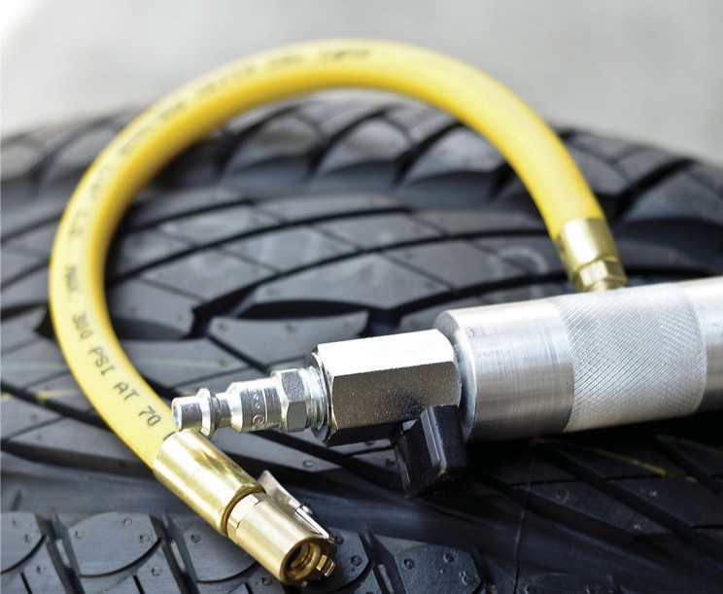
WARNING
 Correct size tire must be used for proper installation of the EASYDRIFT DTS
 The width of the rim is very important. It is proportionate to the tire size.
 Inflating a tire could be dangerous. Give yourself as much distance as possible from the tire. Make sure bead is positioned properly.
 Wear protective glasses or goggles. Safety first.
INSTALLATION
1 - Position wheel horizontally on flat surface, the outside facing up.
2 -
3 -
4 -
5 -
Deflate tire entirely.
Make sure that tire and threads are free from debris and oil. Wipe inner ring surface with a clean cloth.
Position the EASYDRIFT ring so it’s level with the sidewall of the tire. (ring lip should be on outside of wheel ).
- Proceed with tire vacuum instruction (Sold with instruction sheet)
- When tire has reached the last stage of air removal, press D.T.S ring evenly until the outer lip comes in contact with the tire on all points of perimeter.
- Inflate tire to manufacturer max pressure. Use tire cage. Improper tire pressure may cause vibration to vehicle while skidding.
NOTE: Depending on vehicle type & weight, tire pressure could be as low as 30 PSI.
*** Please refer to tire chart for correct size tire
7

Slide 13

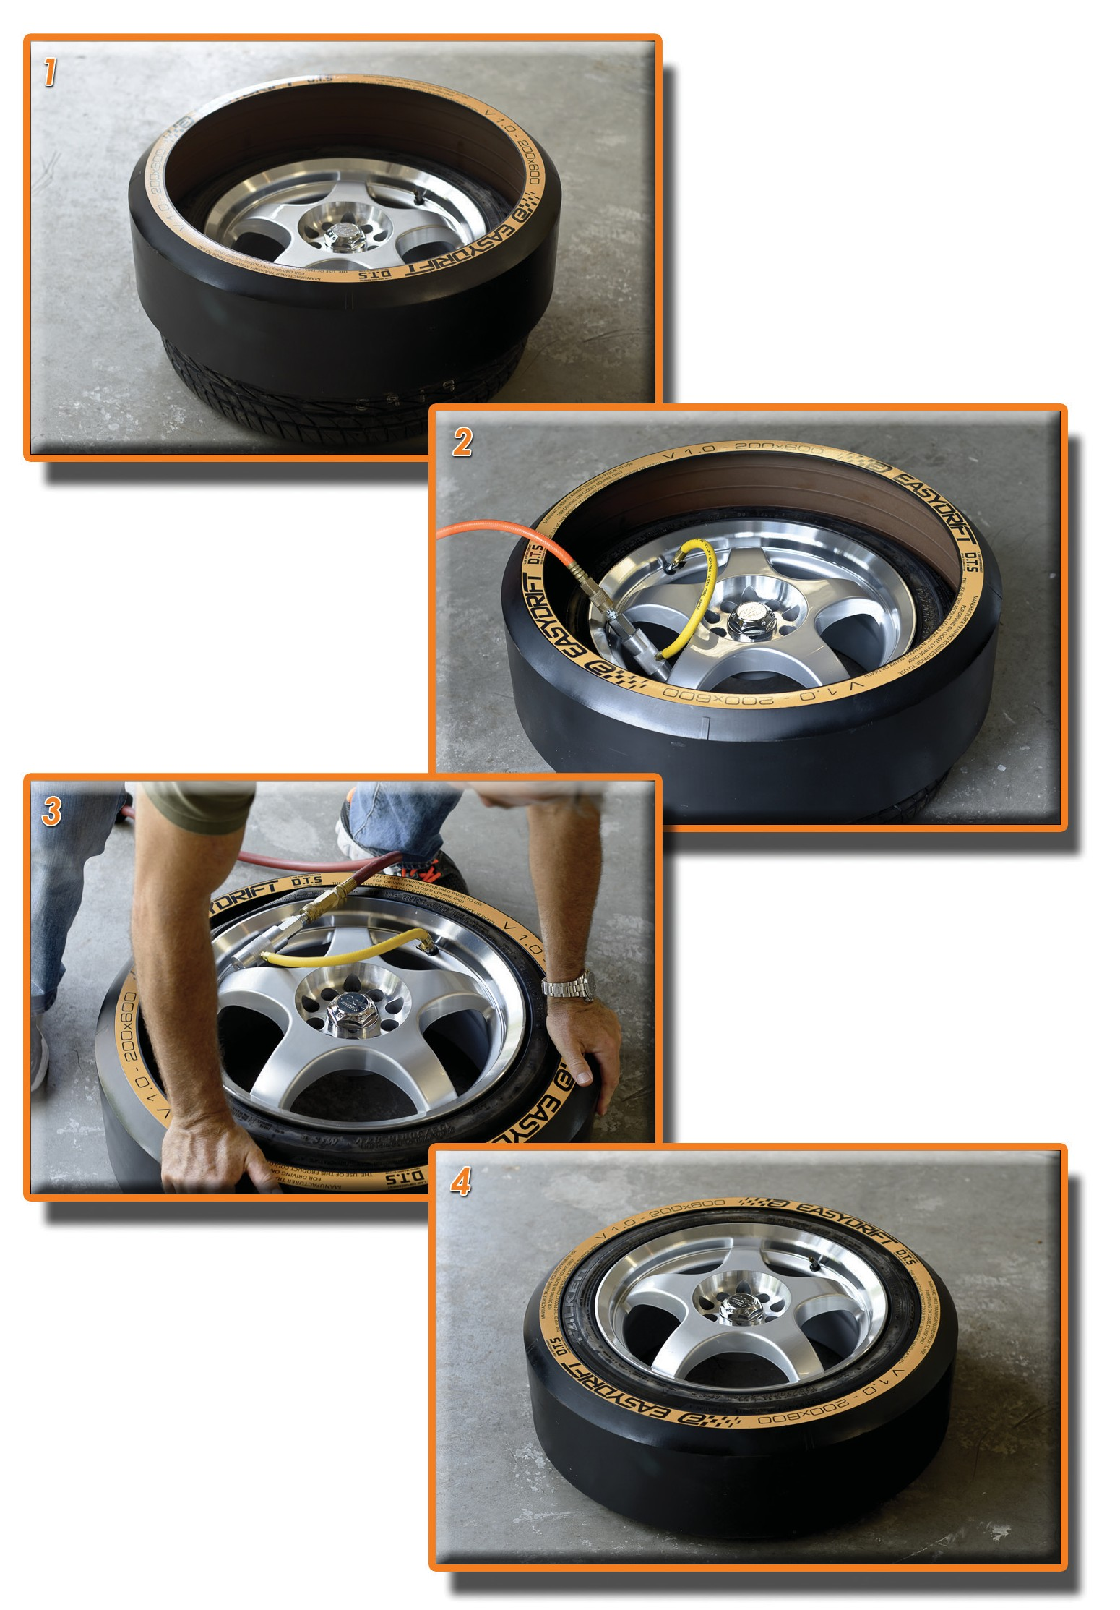
INSTALLATION
8

Slide 14
EXERCISES
9

Slide 15
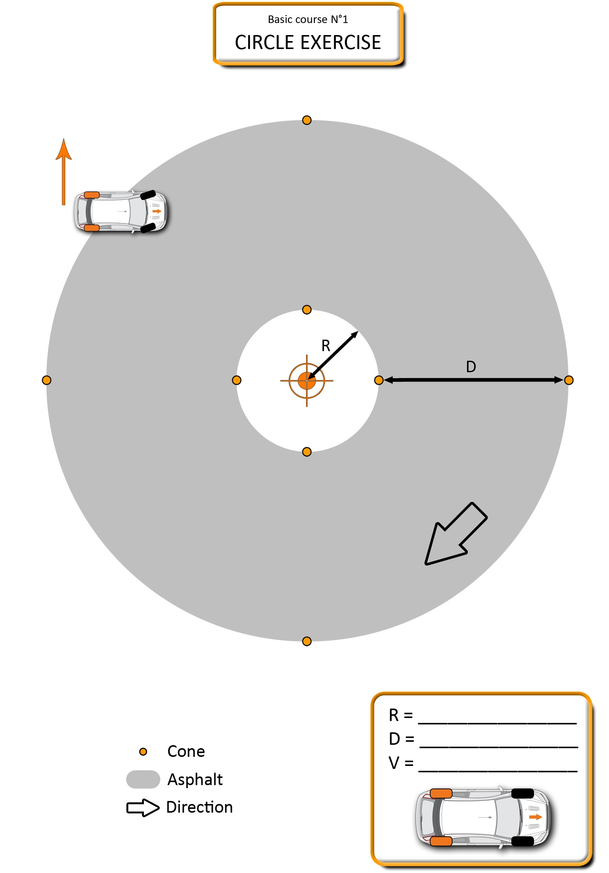

N°1
CIRCLE EXERCISE
R = (15)
D = (30)
V =
Cone
Asphalt Direction
EXERCISES
11

Slide 16
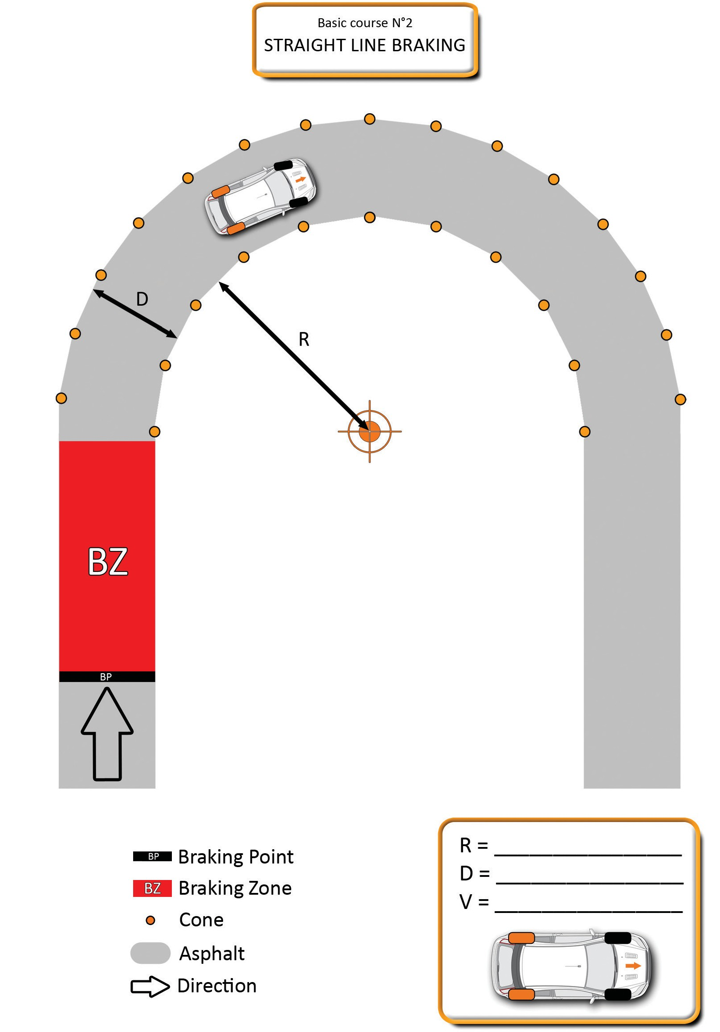

N°2
STRAIGHT LINE BRAKING
Braking Point
Braking Zone Cone Asphalt Direction
R =
D = V =
EXERCISES
13

Slide 17
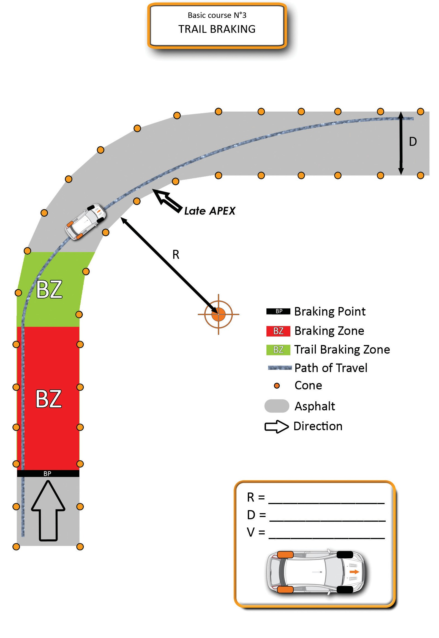

N°3
TRAIL BRAKING
Braking Point
Braking Zone
Trail Braking Zone Path of Travel Cone
Asphalt Direction
R =
D = V =
EXERCISES
15

Slide 18
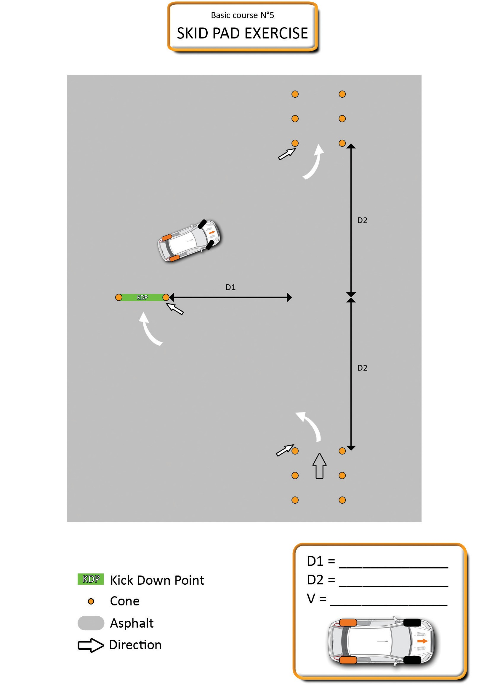

N°4
SKID PAD EXERCISE
APEX
APEX
APEX
R =
D = V =
Kick Down Point
Cone Asphalt Direction
EXERCISES
17

Slide 19
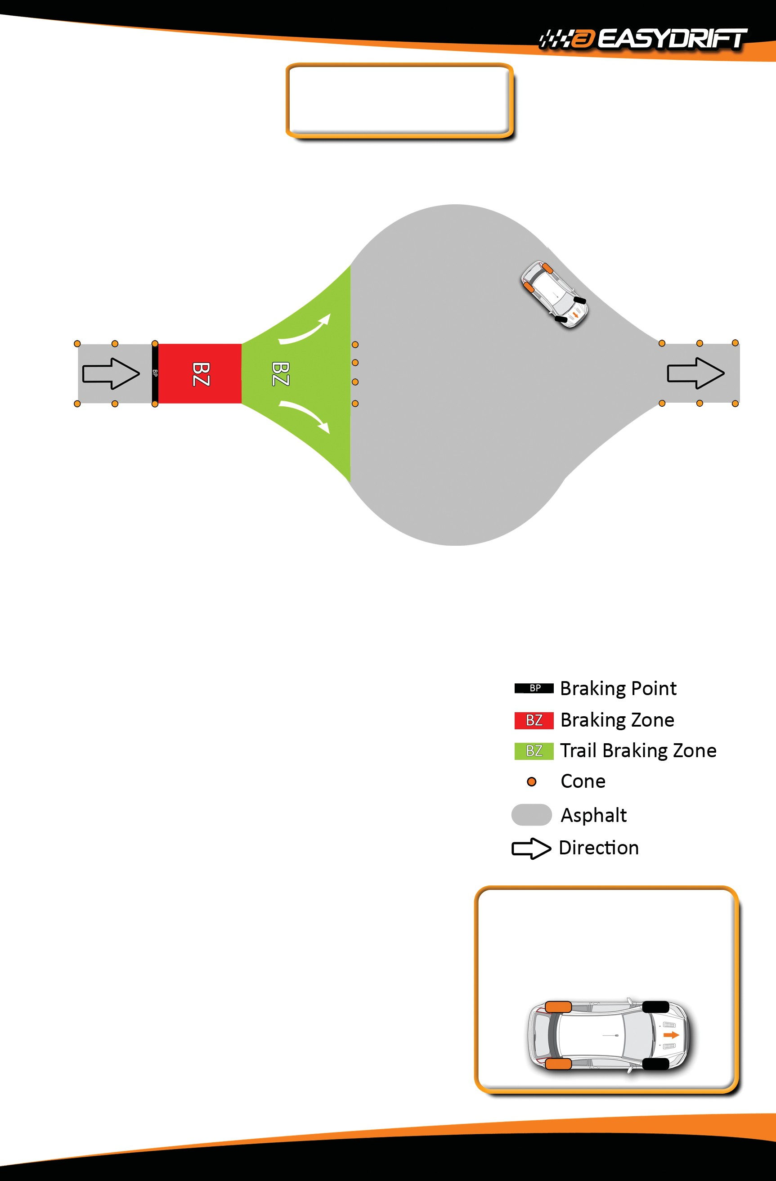

N°5
BRAKE & AVOID
Braking Point Braking Zone
Trail Braking Zone Cone
Asphalt Direction
D = V =
EXERCISES
19

Slide 20
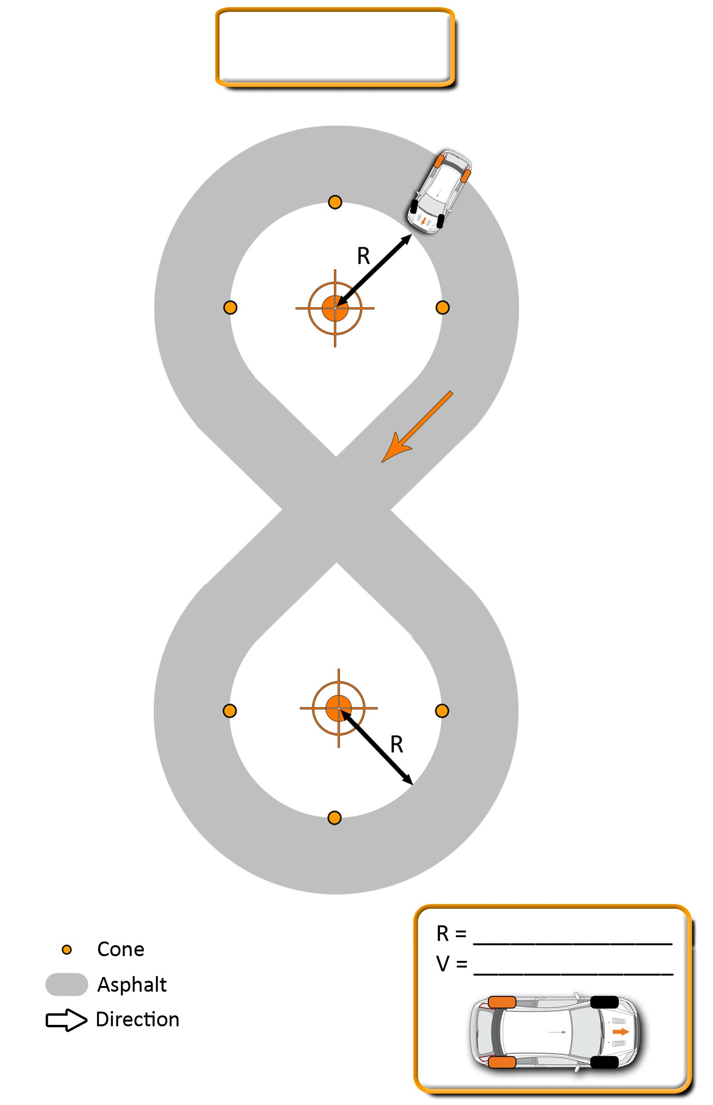

N°6
FIGURE 8
Cone
Asphalt Direction
EXERCISES
21

Slide 21

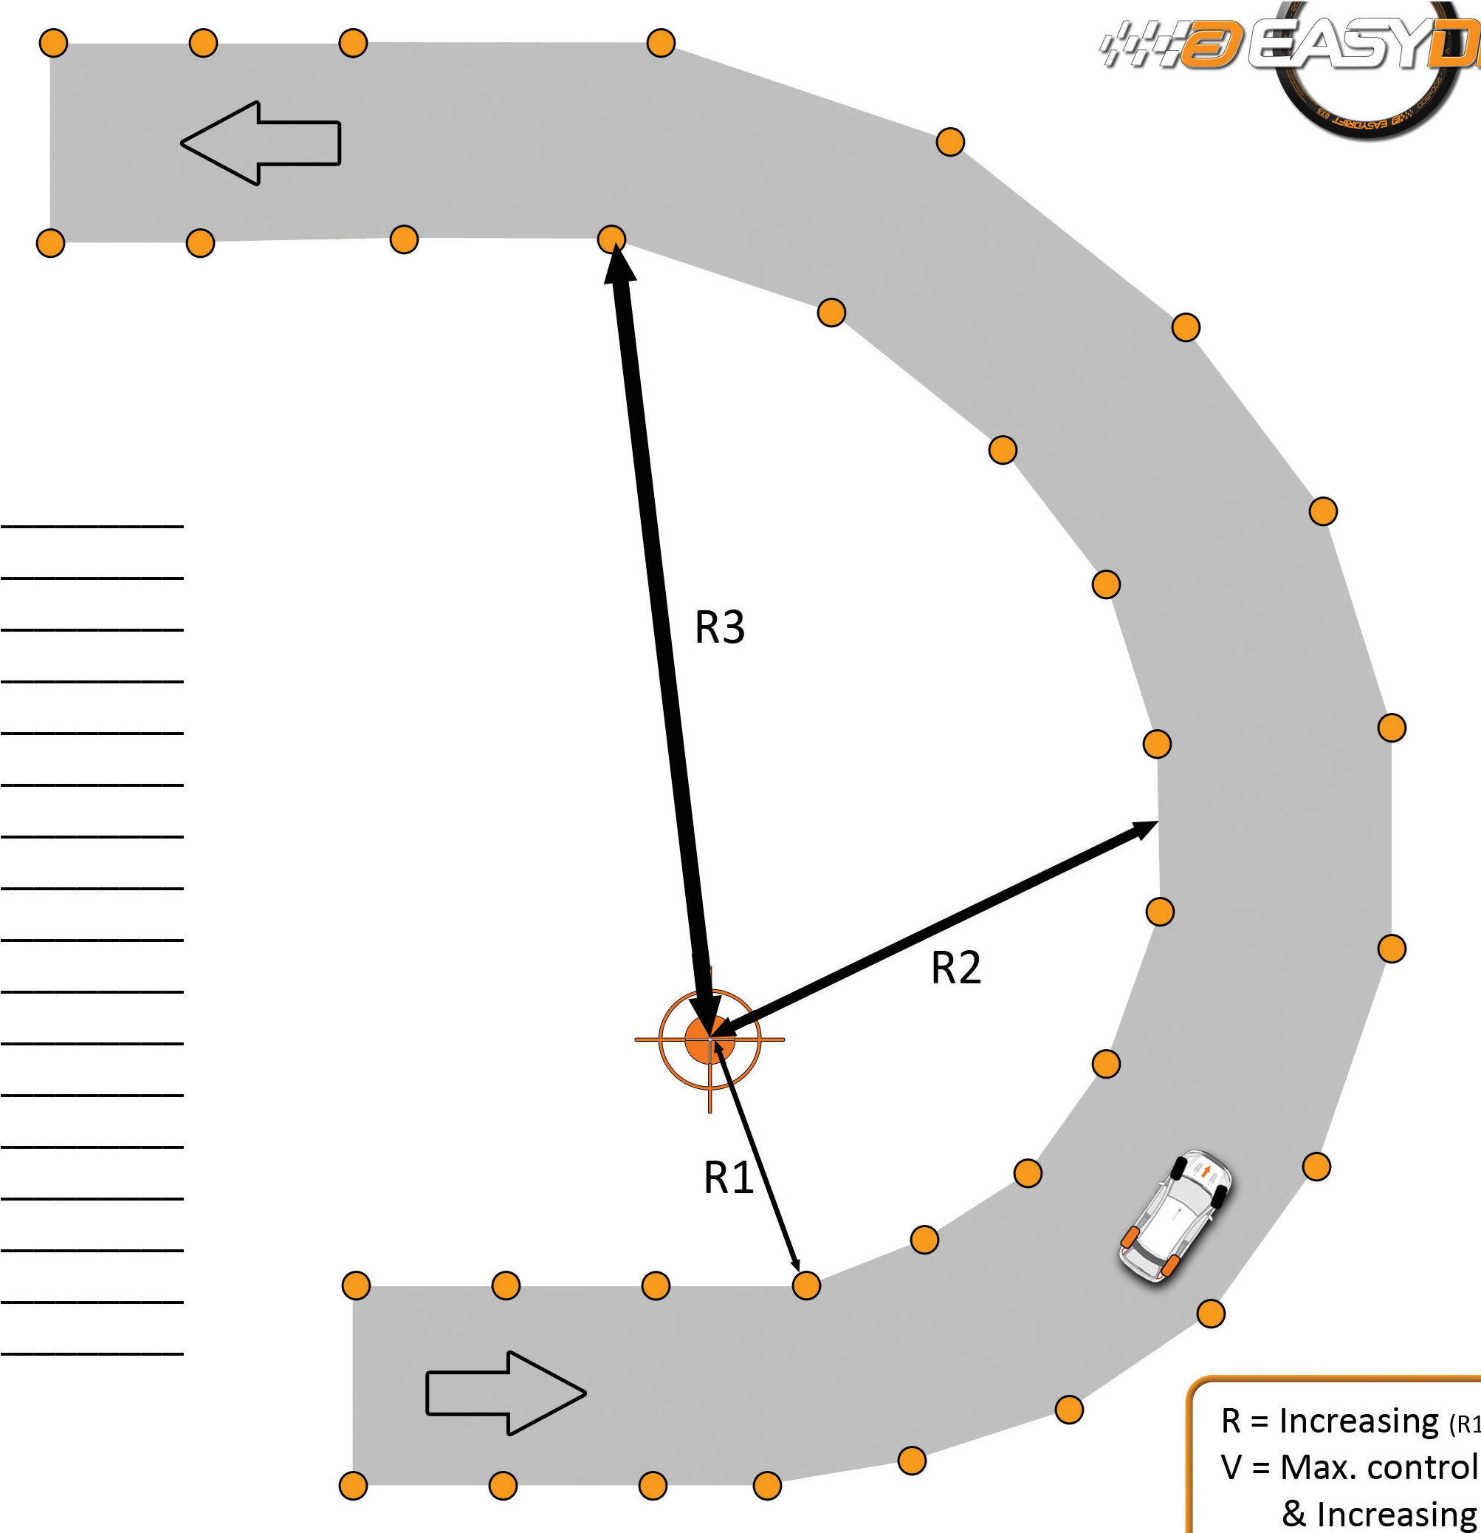

N°7
INCREASING RADIUS EXERCISE
R = Increasing (R1 R2 R3)
^
^
Cone Asphalt Direction
V = Max. controllable & increasing
EXERCISES 23

Slide 22
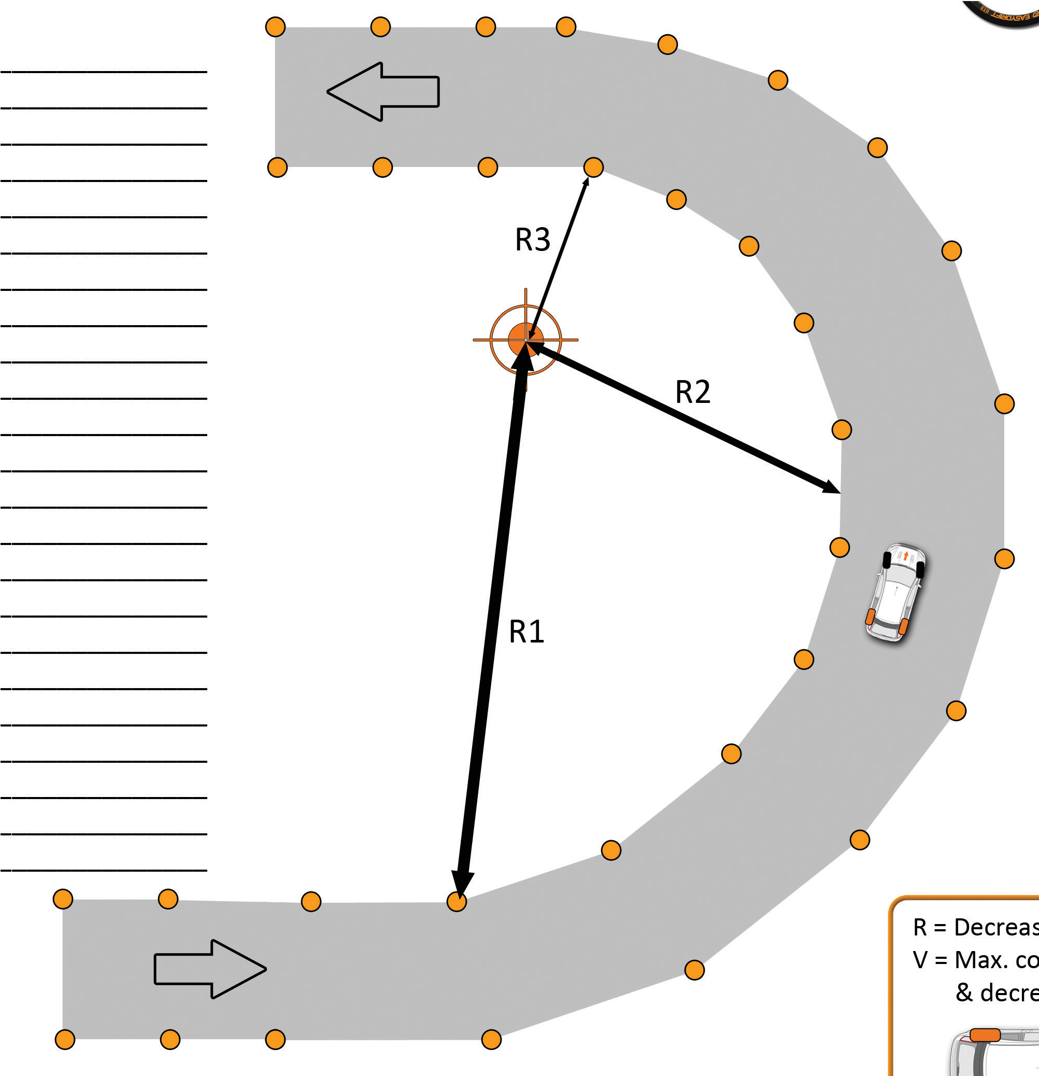

N°8
DECREASING RADIUS EXERCISE
R = Decreasing (R1 R2 R3)
^
^
Cone Asphalt Direction
V = Max. controllable & decreasing
EXERCISES 25

Slide 23
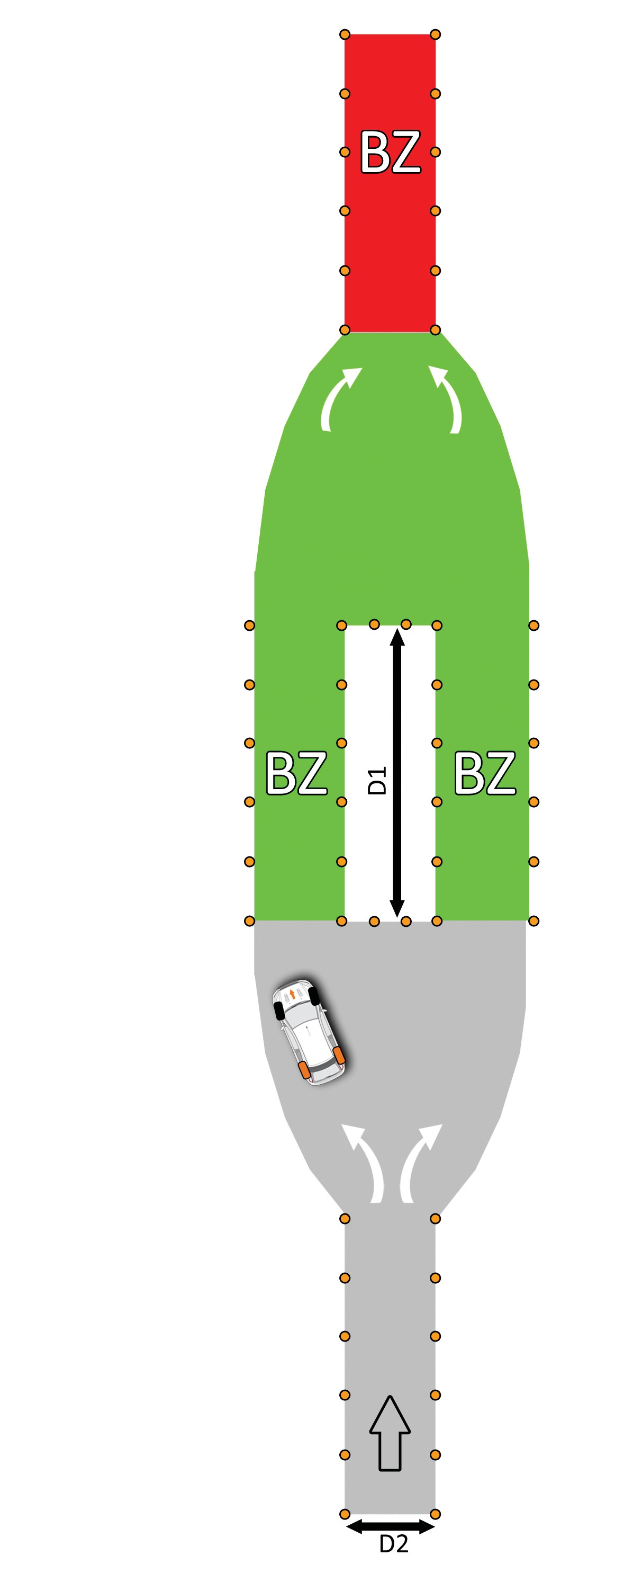
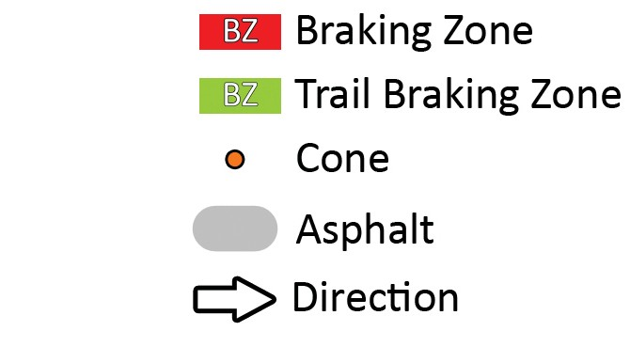

N°9
EVASIVE MANEUVER
Braking Zone
Trail Braking Zone Cone
Asphalt Direction
D1 = D2 =
V =
EXERCISES 27

Slide 24
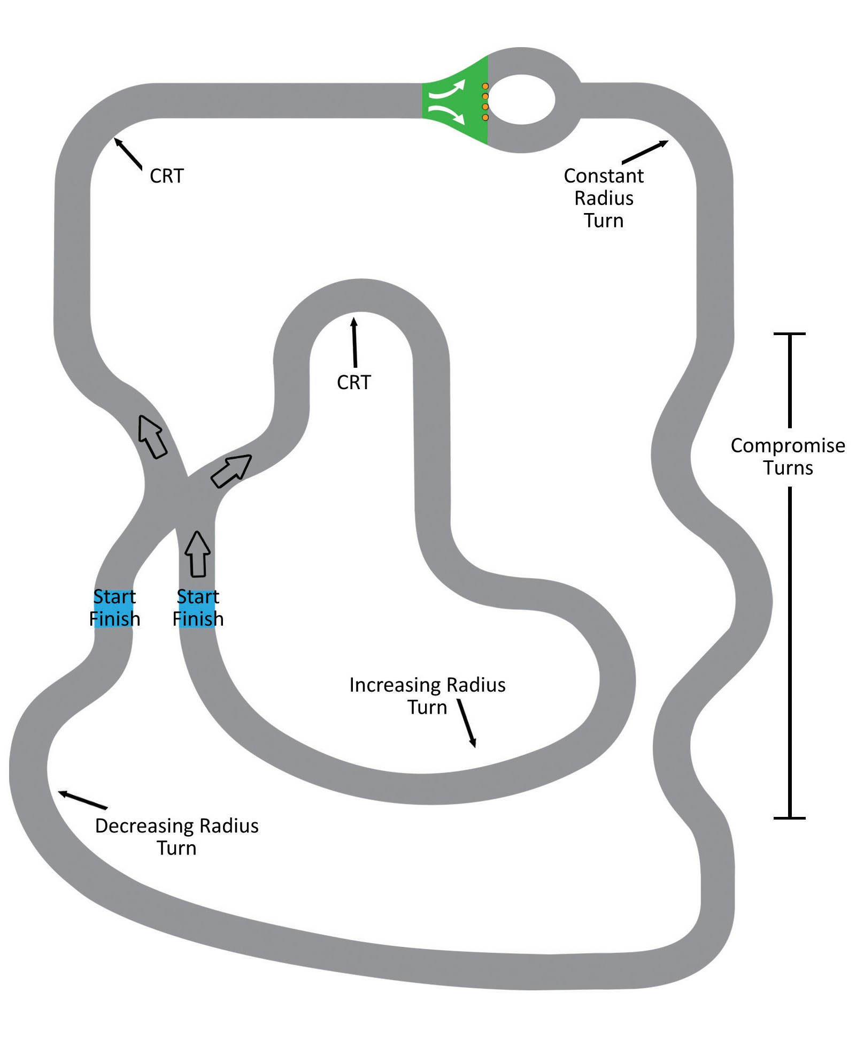

N°10
TIME ATTACK CHALLENGE
EXERCISES 29

Slide 25

FWD - AWD - RWD
 The DTS can be used on all these vehicles.
 The DTS are commonly placed on the rear of the vehicle training for oversteer situations, but we suggest that students experience understeering with the DTS installed on the front of the vehicle.
 All the above exercises can be done in the same matter with a front wheel drive vehicle. We do not recommend using power on a FWD vehicle to help regain directional control. It should only be used by experienced drivers.
 If you are doing basic training it is important to remember that you should not change the matter in which you teach the exercises. Eyes, Hands, Foot coordination is your primary goal.
 If you are instructing on a new course or curriculum, we suggest you practice the course on which you will be teaching in order to reinforce the basics of the EASYDRIFT curriculum to your students.
30

Slide 26


LIABILITY
31

Slide 27

LIABILITY
 Because of its unstable, lack of adherence property, the Easydrift Driver Training System can be a high liability training product.
 The improper use of the Easydrift Driver Training System is potentially dangerous. The missuse of this product could result in serious injury or death.
 The Easydrift Driver Training System should never be used on public roads, right of ways.
 The Easydrift System must be utilized in a CONTROLLED training environment, protected from public access.
 For best utilization, this product should only be used after completion of the Easydrift Basic Instructor Certification Course.
 A certified Easydrift Instructor must be in the Easydrift equipped vehicle at all time while in motion.
 When preparing a driving course and/or exercise, the instructor has to take in consideration the potential of accident either by an undisciplined driver or by a non-controlled environment.
 The environment should be free of bystanders, fixed objects or structure, free of HOLES, CRAKS, GRAVEL, and other loose material.
 The speed at which the exercises are conducted is in direct relations to the size, the type and quality of the surface material of the training pad.
 The vehicle used for training also can be a safety issue. Things to take in consideration: Brakes, suspension, wheels, seat belts, tire pressure.
 Basic safety rules: Driver must have both hands on steering wheel. Speeds must be respected.
 Things to take in consideration: Type of vehicle used for training (weight, center of gravity), surface temperature, how clean is the training surface, size of the pad.
The Easydrift certification is only valid while teaching at a law enforcement function or at a professional driving school
32

Slide 28

SPEEDS
The EASYDRIFT Driver Training System is designed and intended for low speed training use only. Maximum training speeds are dependent, among other things, upon:
 the experience level of the driver,
 the experience level of the trainer,
 vehicle condition,
 weather condition,
 training pad conditions,
 training pad size.
Typical recommended training speeds are 10 mph to 30 mph, but in no case should ever need to exceed 40 mph.
Risks increases exponentially with speed.
Every exercise must have a predetermined speed
set by the instructor.
TOO SLOW = No Skid
TOO FAST = No Recovery
LIABILITY
33

Slide 29
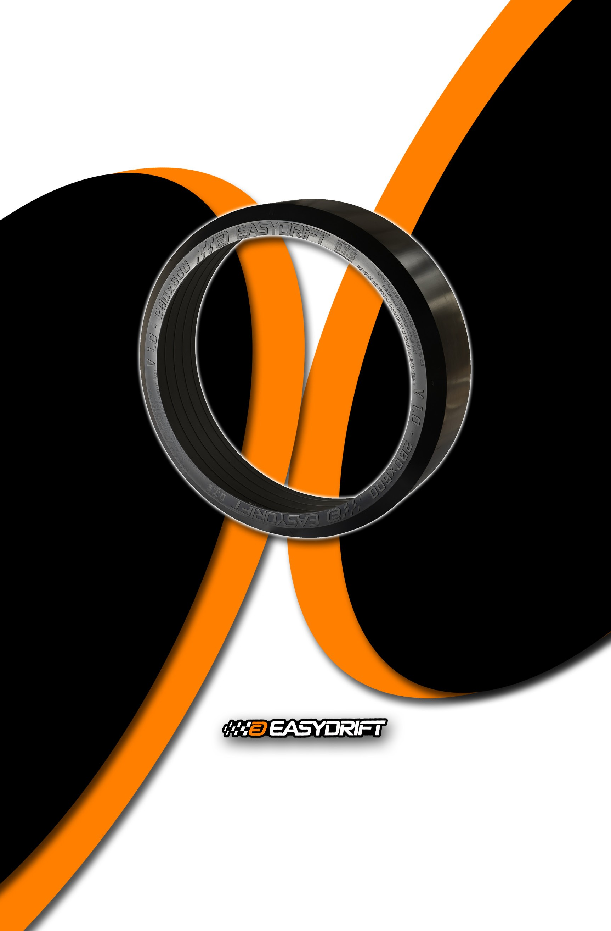
EASYDRIFT, LLC.
Gainesville, Florida
Phone : 352-318-3683
contact@easydriftusa.com
www.easydriftusa.com

